Slide 1
Fertile Crescent
The Land of “Firsts”

Slide 2
A Land of Firsts
Civilization in Mesopotamia began in the valleys of the Tigris and Euphrates Rivers. The rivers provided fish and freshwater, and made it easier to travel and trade. Trade was of utmost importance because it provided a way for goods and ideas to move from place to place. As cities took shape there became a need for organization. The people of the region formed a rudimentary government that made plans and decisions about matters of common concern. The leaders took charge of food supplies and building projects. They made laws to keep order and assembled armies to fend off enemies.
With fewer worries about meeting basic human needs, people in the river valleys had more time to think about other things. They developed religions and the arts. To pass on information, they invented ways of writing. They also created calendars to tell time. Early civilizations had another feature: they had a class system. People held different places in society depending on what they did and how much wealth or power they had.
When and where did the first cities appear? BHP video 10:45

Slide 3
Mesopotamia’s Civilization
Big History Project article on Agrarian Societies
River Valleys were perfect as there was good farming conditions which allowed a large number of people to be fed.
Rivers provided fish and freshwater and provided for a way for goods and ideas to move from place to place. (BHP Superpower of Salt video)
With so many people there was a need for organization; plans and decisions needed to be made about matters of common concern
Formation of governments
With fewer worries, people had time to think about other things such as religion and the arts
Invented ways of writing to pass these ideas to others
Class structure depending on work and how much wealth and power held

Slide 4
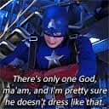
sumer
Mesopotamia had a hot, dry climate. In the spring, the rivers often flooded leaving behind rich soil for farming. The problem was the flooding was not consistent and farmers continually worried about their crops. They came to believe that they needed the intercession of the gods to prevent their crops from dying. Eventually the farmers learned to build dams and channels to control the seasonal floods. They also built walls, waterways, and ditches to bring water to their fields. This irrigation allowed farmers to grow abundant crops and to support a large population of people.

Slide 5
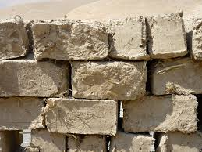
Sumer X2
Because of the flooding and rich soil leading to abundant crops feeding a large population many cities began to be constructed in southern Mesopotamia in a region known as Sumer. Sumerian cities were isolated from each other by geography. The terrain around the cities was most inhospitable making travel and communication difficult. Each Sumerian city became a separate city-state which had its own government and was not part of any larger unit. Sumerian cities often went to war with one another. They fought to gain glory and to control more territory. For protection, each city-state surrounded itself with a wall. Because stone and wood were in short supply, the Sumerians made bricks out of dried river mud combined with reeds.
Crash Course video Mesopotamia 12:07

Slide 6
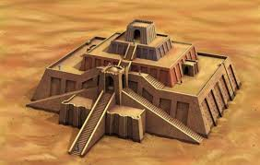
Sumer x3
The Sumerians were polytheistic believing in many gods. Each god was thought to have power over a natural force or a human activity-flooding, basket weaving, etc. The Sumerians tried hard to please each god. Each city-state built a grand temple called a ziggurat to its chief god. The ziggurat dominated the city. At the top was a shrine that only priests and priestesses could enter. The priests and priestesses were powerful and controlled much of the land. They may have even been rulers at one time. The ruling switched to kings who ruled as hereditary monarchs.

Slide 7
Sumer x4
Sumerian social structure:
Sumerian kings lived in palaces, ordinary people lived in small mud-brick houses.
Most people were farmers
Some were artisans (skilled workers who made metal products, cloth, or pottery)
Others worked as merchants or traders trading tools, wheat, and barley for copper, tin, and timber
People divided into three social classes: upper class included kings, priests, and government officials; middle class was made up of artisans, merchants, farmers, and fishers (largest class); lower class: enslaved people who worked on farms or temples
Males headed households and could go to school
Women could run businesses and could buy and sell property

Slide 8
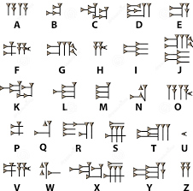
Sumer x5
Invented writing
Developed writing to keep track of business deals and other events in cuneiform.
Cuneiform= hundreds of wedge-shaped marks cut into damp clay tablets with a sharp-ended reed.
Only boys from wealthy families learned how to write; after ten years of training they became scribes
Invented wagon wheel, plow, sailboat
Used geometry to measure fields and put up buildings
Created a number system based on 60 = hour, minute and 360-degree circle
Noted position of planets to learn best times to plant crops and hold religious festivals
Developed 12-month calendar based on the moon cycles

Slide 9
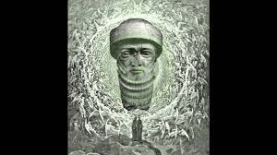
Sumer x6
Kahn Academy video on Ancient Mesopotamia 9:23
Kahn Academy video on Ancient Mesopotamia and the Hebrew Bible 8:00
Kahn Academy article on Ancient Mesopotamia

Slide 10
Invaders from the north
Conflicts between the city-states led to them becoming vulnerable to attack.
The king of the Akkadians, Sargon, conquered all of Mesopotamia and set up the world’s first empire. Lasted for 200 years until invaders destroyed it.
The Babylonians led by Hammurabi began another empire. Big center of trade.
Hammurabi’s Code influenced later laws
Prezi created by Matthew Grace

Slide 11
Hammurabi’s code activity page 22 in text
Code of Hammurabi
A house has fallen on and killed its owner because of bad nails and boards. What should be done to the carpenter who built the house?
A sister of god (a nun) has entered a bar for a drink. The bar is known for immoral behavior and housing criminals. What should happen to the nun?
A man has taken out large amounts of loans and owes a lot of people money. What should happen to this man if he is unable to pay his debts?
A bar is known for housing criminals and people who rebel against the government. It has been a problem for years and it has been getting worse. What should happen to a bar owner who cannot get rid of bad characters?
A wife has been gossiping about her husband. She has not been doing work around the house, let's her mother take care of the kids, and spends all of the money? What should be done to a woman who ignores her husband and family?

Slide 12
Hammurabi’s Code x2
A son, born to very poor parents, is given up for adoption by the parents. The birth parents use the money to work out a better life for themselves. After twelve years, they decide that they want their son back from his adopted home. What should be done if the son is adopted and the birth parents want him back?
Like all children and parents, fights occur. Most are nonviolent, with words being thrown around like punches. In traditional society, son is to honor the father no matter what is said. If the fight does get violent, it is the son's job to be submissive and stop. However, what should happen to a boy who strikes his father first?
One man accuses another of stealing a small amount of money. There is not a lot of
proof one way or another. How is the truth going to be determined when one man
accuses another?
http://www.phillipmartin.info/hammurabi/hammurabi_teacherpage.htm
https://sheg.stanford.edu/hammurabis-code

Slide 13


assyrians
1,000 years after Hammurabi
Lived near fertile land so created huge army to defend it; well-organized with foot soldiers armed with spears and daggers, others with bows, chariot riders and cavalry
They were the first to use iron weapons; iron is normally too soft as a material of war but the Hittites developed a way to make the iron more durable and taught the Assyrians.
To attack cities, they tunneled under walls or climbed over them on ladders; used tree trunks as battering rams

Slide 14
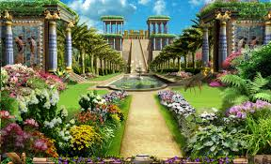
chaldeans
Led by King Nebuchadnezzar
Descended from Babylonians and rebuilt Babylon which became world’s largest and richest city
Hanging Gardens built for king’s wife who missed mountains and plants of her homeland
Made first sun dial
First to have seven-day week
Conquered by Persians

Slide 15
Homework and Review
Fertile Crescent Quizlet
Sumerians info
Ancient River Valley civilizations
Mesopotamia specific
Geography of Fertile Crescent ppt owned and created by Adam Elroy
Fertile Crescent test owned and created by Melanie Salter
Fertile Crescent writing project owned and created by Amy Smith
Ancient Mesopotamia popular culture
BHP activity on social power and burial rites (connect to Crash Course lesson 1.2.1

